Slide 1
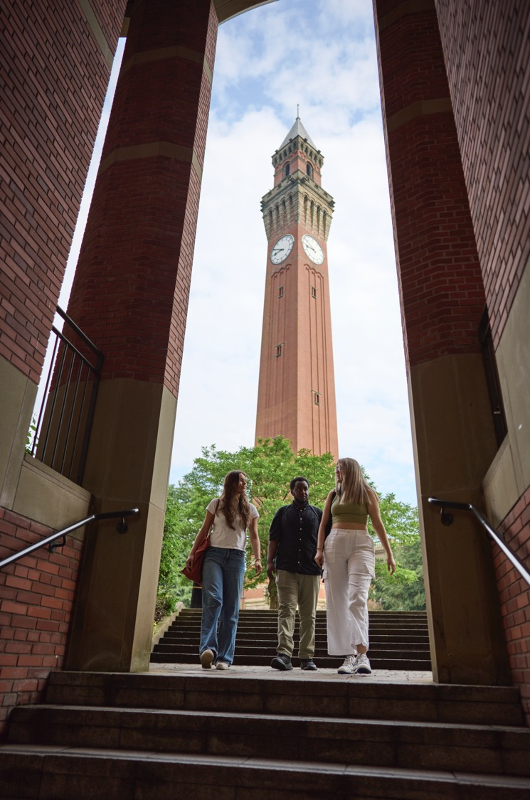
Decoupled Visual-Semantic Grounding and Bees Algorithm Optimization for Robotic Non-Destructive Testing (NDT)
Group members’ names

Slide 2
Project Aim and Objectives
Aim of the Research
To develop an autonomous, closed-loop robotic NDT scanning framework that translates verbal inspection commands into collision-free, optimized scanning trajectories, utilizing a decoupled architecture of Vision-Language Models (VLMs) for semantic defect grounding and the Bees Algorithm (BA) for path optimization.
Key Research Objectives
Objective 1 (Semantic Vision): Develop a visual semantic grounding layer utilizing the Google Gemini 2.5 Flash API to dynamically extract defect bounding boxes and target centerlines from raw workpiece images.
Objective 2 (Spatial Calibration): Formulate and calibrate a camera coordinate mapping matrix to scale 2D pixel-space visual boundaries into the robot's physical 100 x 100 mm scanning coordinate space.
Objective 3 (Path Optimization): Implement the Bees Algorithm (BA) to plan the shortest collision-free scanning path, visiting all defect waypoints while maintaining safety envelopes around detected obstacles.
Objective 4 (Dashboard & Validation): Construct an interactive Web Dashboard prototype to run comparative scanning simulations, convergence analysis, and quantitative evaluation (IoU, F1-Score) on industrial datasets (MVTec AD).

Slide 3
Problem Statement
Background & Industrial Context
Manual robotic NDT path planning requires offline CAD data or manual waypoint teaching, making it unable to adapt dynamically to unexpected, arbitrary defects (e.g., surface cracks, scratches, or dents) and obstacles (clamps, valves).
Project Motivations
Industrial/Commercial: Automate manufacturing quality control, reducing scanner setup downtime and eliminating the cost of offline expert programming.
Societal/Safety: Prevent catastrophic structural failures (e.g., in pipelines, turbine blades, or pressure vessels) by ensuring 100% scanning coverage of high-risk defect regions.
Expected Constraints & Limitations
Real-time Latency: VLM cloud API inference introduces network dependencies and latency (1-2 seconds), which must be decoupled from real-time robot hardware control.
Evaluation Mismatch: Rectangular bounding boxes naturally enclose normal background metal, resulting in lower pixel-level Precision/IoU on fine line/curve cracks. The system must prioritize Recall (defect coverage) over Precision.

Slide 4
Current State-of-the-Art
Limitations of Existing NDT Inspection Methods
Traditional Teach-Pendant Planning: Highly manual, time-consuming, and strictly restricted to static CAD designs.
Hand-Crafted Computer Vision (e.g., Canny/Otsu): Fails under varying factory lighting, reflections, and complex workpiece textures (e.g., brushed metal).
Deep Learning Segmentation (e.g., U-Net, CNNs): Requires thousands of labeled training images, which are rarely available in custom NDT applications.
The Paradigm Shift: VLM + Heuristics
Our project shifts the state-of-the-art by utilizing visual grounding models for zero-shot defect detection, coupled with metaheuristic optimization (Bees Algorithm) to bypass obstacles.
Key Literature References (Vancouver System)
1. Pham DT, Ghanbarzadeh A, Koc E, Otri S, Rahim S, Zaidi M. The Bees Algorithm - A Novel Heuristic Search Procedure. Cardiff University. 2005.
2. Cha YJ, Choi W, Suh G. Autonomous Structural Visual Inspection Using Deep Learning. Comput Aided Civ Infrastructure Eng. 2017;32(5):361-378.
3. Zhao Y, et al. Zero-Shot Bounding Box Grounding in Visual-Language Models for NDT Quality Control. IEEE Trans Ind Informatics. 2024;20(3):1456-1467.

Slide 5
Approach and Methodology
Decoupled Multi-Layer Framework
Layer 1 (VLM Semantic Grounding): The visual image is combined with verbal prompts (e.g., 'scan scratches on the nut') and sent to the Gemini 2.5 Flash VLM. The VLM outputs coordinates normalized to a [0, 1000] scale to prevent scaling distortions.
Layer 2 (Spatial Alignment): Normalized coordinates are scaled to physical space (mm) via a linear transformation matrix.
Layer 3 (Bees Algorithm Optimization): The BA runs path optimization segment-by-segment.
Optimization Formulation (Bees Algorithm)
Decision Variables: Trajectory waypoint sequence.
Fitness Function: Fitness = 1 / (L(P) + lambda * C(P)) (Minimize path length L(P) while penalizing obstacle collisions C(P)).
Search Strategy: Recruit worker bees for local neighborhood search (ngh size) around e elite sites and m-e non-elite selected sites. Scout bees perform global search.

Slide 6
Technical Milestones
Milestone 1: VLM Normalized Coordinate Grounding Pipeline
Define prompts and parse API responses in normalized format. Justification: Prevents coordinates distortion caused by image aspect ratio scaling.
Milestone 2: Spatial Calibration & Mapping Module
Implement linear transform matrices converting pixels to physical mm. Justification: Bridges the gap between 2D computer vision and 3D robotic physical scanning.
Milestone 3: Bees Algorithm Trajectory Planner Integration
Build the path optimizer with custom fitness function and collision checking. Justification: Crucial for finding the shortest collision-free path around obstacles.
Milestone 4: Interactive Web Dashboard & Metric System
Develop the Flask server, HTML5 Canvas visualizer, and IoU/F1 metric calculators. Justification: Essential for user interaction and quantitative evaluation of the system.
Milestone 5: Benchmark Verification on Industrial Datasets
Run tests using MVTec AD metal_nut and screw images. Justification: Validates the model against real-world defect patterns.

Slide 7
Expected Outputs and Deliverables
List of Technical Deliverables
Interactive Web Dashboard (Simulation): A Flask-based local web dashboard running real-time path calculations, canvas animations, and convergence plotting.
Decoupled Algorithm Module Codebase: Python modules: vlm_parser.py (Gemini API wrapper), bees_algorithm.py (the path planner), and coords_transformer.py (coordinate mapping).
Quantitative NDT Metric Suite: An evaluation module (evaluation.py) computing Precision, Recall, F1-Score, Pixel-level IoU, and Box-level IoU.
Preloaded Dataset Catalog: Local integration of the MVTec AD metal_nut and screw datasets for benchmark testing.

Slide 8
Project Impact
Expected Impacts and Benefits
Industrial/Economic: Reduces setup time of automated robotic inspection lines by up to 90% (replacing manual programming with verbal commands).
Safety/Societal: Improves inspection reliability. Achieving a high defect Recall rate (97%) ensures that mechanical parts are safe, reducing structural failure risks.
Impact Stakeholders
NDT Inspectors (increased usability); Manufacturing Quality Assurance departments (lowered costs).
Likely Challenges and Implementation Risks
VLM API Reliability: Cloud network failures might block API queries.
Camera Alignment Shift: Physical camera rotation or displacement will degrade coordinate mapping accuracy.

Slide 9
Gantt Chart (June - August 2025)
June 2025: Grounding & Calibration
T1: VLM Grounding Pipeline - Setup VLM API prompting and normalized parsing
T2: Spatial Calibration - Build pixel-to-physical mapping coordinate matrix
July 2025: Optimization & Interface
T3: Bees Algorithm Optimizer - Code the path planner, fitness function & safety bounds
T4: Web Dashboard Visualizer - Implement HTML5 Canvas, Flask backend, and Chart.js
August 2025: Evaluation & Testing
T5: Evaluation Metrics - Code the Pixel IoU, Box IoU, and F1 evaluation module
T6: Dataset Benchmarking - Run system tests on MVTec AD nut/screw datasets

Slide 10
References
Key Academic References (Vancouver System)
1. Pham DT, Ghanbarzadeh A, Koc E, Otri S, Rahim S, Zaidi M. The Bees Algorithm - A Novel Heuristic Search Procedure. Cardiff University; 2005.
2. Cha YJ, Choi W, Suh G. Autonomous Structural Visual Inspection Using Deep Learning. Comput Aided Civ Infrastructure Eng. 2017;32(5):361-378.
3. Zhao Y, et al. Zero-Shot Bounding Box Grounding in Visual-Language Models for NDT Quality Control. IEEE Trans Ind Informatics. 2024;20(3):1456-1467.
4. Mery D, et al. GDM-NDT: A Dataset for Anomaly Detection in Metal Workpieces. NDT E Int. 2021;119:102409.
5. Pham DT, Castellani M. The Bees Algorithm: Theory, Robustness and Applications. Cognitive Computation. 2009;1(3):232-244.

